Slide 1

Foreign Direct Investment Trends
This presentation analyzes foreign direct investment (FDI) data across various sectors in a country from 2000 to 2017. The analysis focuses on identifying the top investment sectors and overall investment trends over time.
By Neha Mondal

Slide 2




Data in Detail
Modified Sectors
Years
ENERGY PRODUCTION | ELECTRICAL MACHINES | COMUNICATION | TRANPORT INDUSTRIES | MACHINARIES AND INTRIMENTS | AGRICULTURAL SECTOR | MEDICAL SECTOR | FOOD SECTOR | TEXTILES AND GOODS SECTOR | SEVICES SECTOR | EDUCATION SECTOR | CONTRUCTION | IMPORTANT INDUSTRIES | OTHER
The provided data gave information about foreign direct investments from year 2000 to 2017

Slide 3

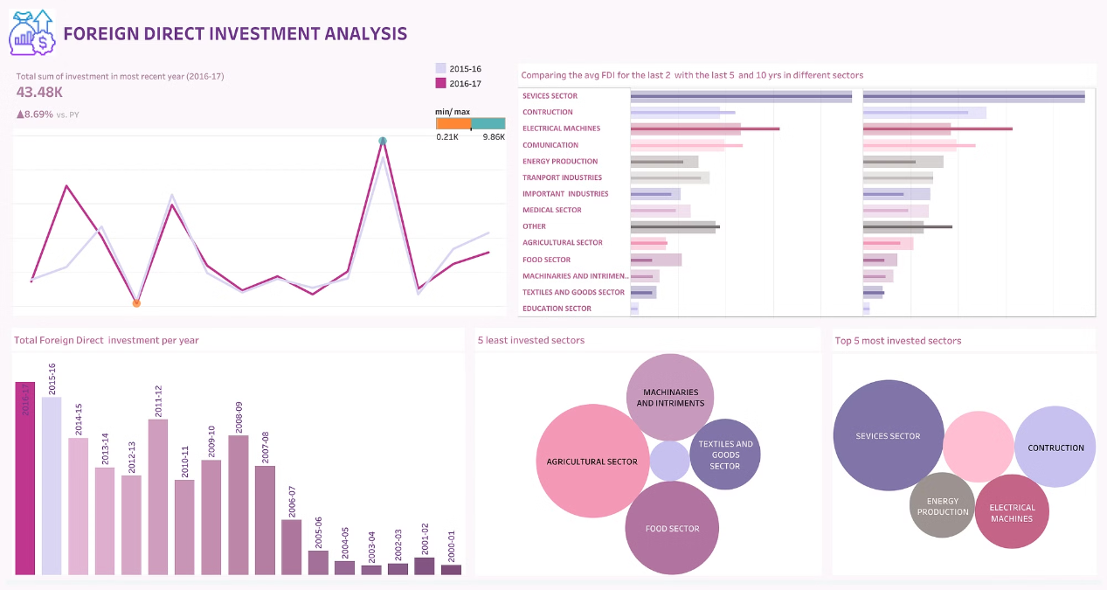

Slide 4

Total FDI Inflows
2000-2006
1
FDI inflows saw steady growth, with the total increasing from 2.2k to 5.5k .
2
2007-209
FDI inflows accelerated, reaching a peak of 31.4k in 2009 as the economy expanded.
2010-2012
3
Inflows declined moderately in this 2010 and 2011 with sudden hike in 2012 with 35.1k.
4
2013 to 2017
FDI shows a steady growth during this period with peak at 2017 with 43.5k

Slide 5


Top Sectors for FDI
Service Sectors
Telecommunications
Manufacturing
The energy sector consistently attracted the highest FDI, reaching 9.8k in 2017.
Telecommunications was another top draw, with investments growing from 2.3k to 7.1k.
FDI in manufacturing sectors like electrical machinery and transport equipment was also significant.

Slide 6
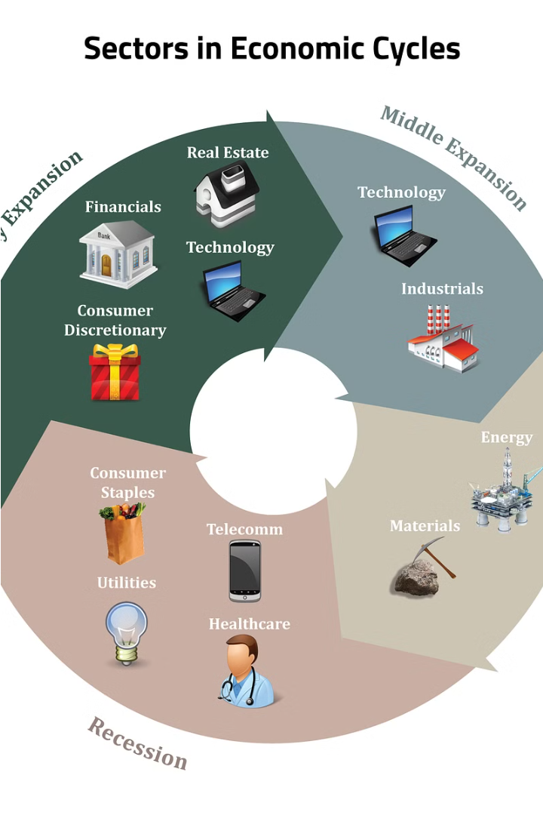
Emerging Sectors
1
Textile and Goods sector
FDI in the Textile and Goods sector increased from an avg of 372 to an avg of 907, driven by investments in new online shopping market.
2
Transport
Transportation networks support international trade and economic cooperation between nations. From an avg of 1.4k to an avg of 2.9k in comparison between last 17 years with last 2 years
3
Education
The education sector saw a surge in FDI, comparing last 17 years to last 2 years from an avg of 121 to an avg of 283, as international universities and training providers expanded.

Slide 7




Sectoral Shifts
2000
Manufacturing, energy, and infrastructure dominated FDI inflows.
2010
Services sectors like telecommunications and finance gained prominence.
2017
Emerging sectors like healthcare, education, and food processing became significant FDI recipients.

Slide 8




Investor Profiles From current situations
Manufacturing
Energy
Major manufacturing investors include multinational corporations from the US, Europe, and Asia.
State-owned and private oil and gas companies from the Middle East, Russia, and China are key players.
High-Tech
Technology giants from the US and East Asia have made significant investments in the digital economy.

Slide 9

Policy Implications
Sustain Investor Confidence
Maintain a stable and business-friendly policy environment to retain and attract FDI.
Diversify Investment Flows
Encourage FDI in emerging sectors like healthcare, education, and food processing to spur economic transformation.
Promote Regional Equity
Implement targeted incentives and infrastructure improvements to direct FDI to underserved regions.

